Slide 1


Computer Network-Practical’s
https://www.youtube.com/watch?v=ZpgHk-NR-bw

Slide 2
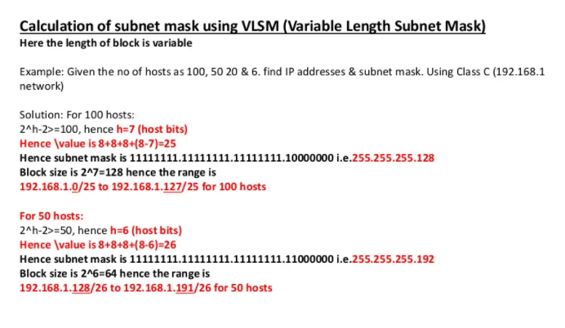
Subnetting

Slide 3
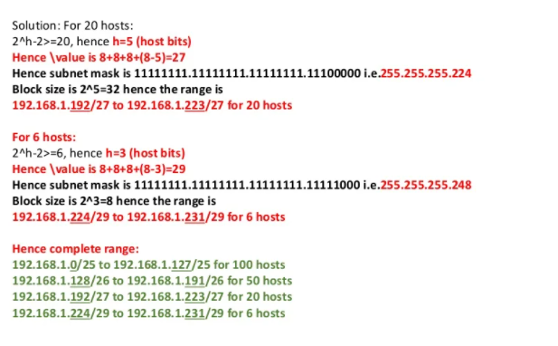
Subnetting

Slide 4
VLSM-Variable Length Subnet Mask
VLSM stands for Variable Length Subnet Mask where the subnet design uses more than one mask in the same network which means more than one mask is used for different subnets of a single class A, B, C or a network. It is used to increase the usability of subnets as they can be of variable size. It is also defined as the process of subnetting of a subnet.
Procedure of implementing VLSM – In VLSM, subnets use block size based on requirement so subnetting is required multiple times. Suppose there is an administrator that has four departments to manage. These are sales and purchase department with 120 computers, development department with 50 computers, accounts department with 26 computers and management department with 5 computers.

Slide 5
VLSM-Variable Length Subnet Mask
What are the network addresses?
Subnet 1: (size of 64)
network address: 192.168.1.0
Subnet 2: (size of 32)
network address: 192.168.1.64
Subnet 3: (size of 16)
network address: 192.168.1.96
Subnet 4: (size of 4)
network address: 192.168.1.112
Subnet 5: (this is where the free space starts)
network address: 192.168.1.116
https://networklessons.com/subnetting/variable-length-subnet-mask-vlsm

Slide 6
VLSM-Variable Length Subnet Mask
What are the broadcast addresses?
Subnet 1: (size of 64)
network address: 192.168.1.0
broadcast address: 192.168.1.63
Subnet 2: (size of 32)
network address: 192.168.1.64
broadcast address: 192.168.1.95
Subnet 3: (size of 16)
network address: 192.168.1.96
broadcast address: 192.168.1.111
Subnet 4: (size of 4)
network address: 192.168.1.112
broadcast address: 192.168.1.115

Slide 7
VLSM-Variable Length Subnet Mask
What is the subnet mask?
256 – subnet size = subnet mask
Subnet 1: 256 – 64 = 192 so the subnet mask is 255.255.255.192
Subnet 2: 256 – 32 = 224 so the subnet mask is 255.255.255.224
Subnet 3: 256 – 16 = 240 so the subnet mask is 255.255.255.240
Subnet 4: 256 – 4 = 252 so the subnet mask is 255.255.255.252

Slide 8
VLSM-Variable Length Subnet Mask
What are the usable host IP addresses?
Subnet 1: (size of 64)
network address: 192.168.1.0
first host: 192.168.1.1
last host: 192.168.1.62
broadcast address: 192.168.1.63
Subnet 2: (size of 32)
network address: 192.168.1.64
first host: 192.168.1.65
last host: 192.168.1.94
broadcast address: 192.168.1.95
Subnet 3: (size of 16)
network address: 192.168.1.96
first host: 192.168.1.97
last host: 192.168.1.110
broadcast address: 192.168.1.111
Subnet 4: (size of 4)
network address: 192.168.1.112
first host: 192.168.1.113
last host: 192.168.1.114
broadcast address: 192.168.1.115

Slide 9
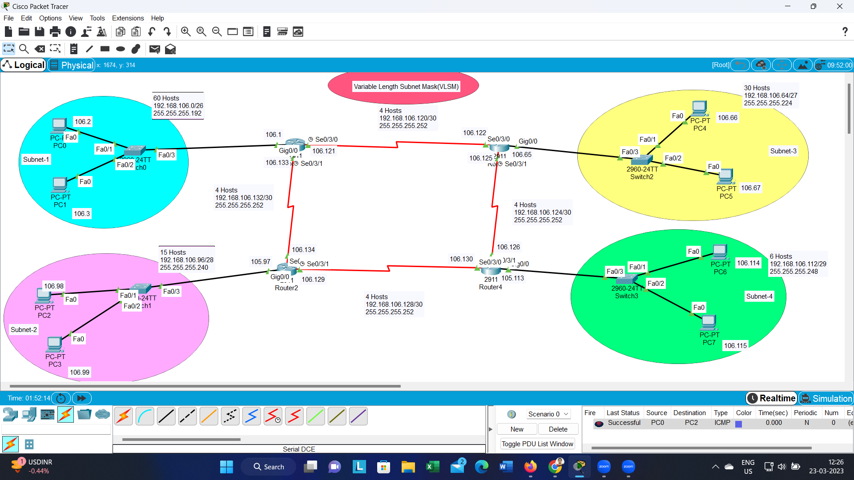
VLSM-Variable Length Subnet Mask
https://www.youtube.com/watch?v=ZpgHk-NR-bw

